Slide 1

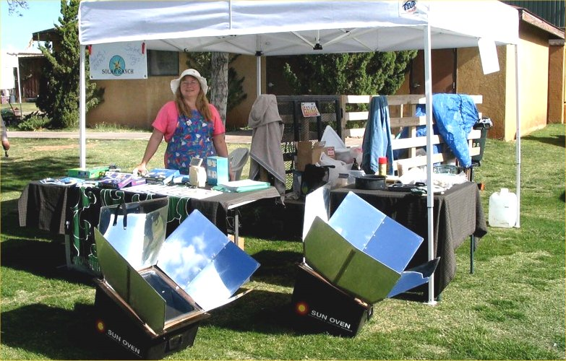
The Basics of
Solar Cooking
Presented by Rose Marie Kern
Author of
The Solar Chef: A Southwestern Recipe Book for Solar Cooking

Slide 2
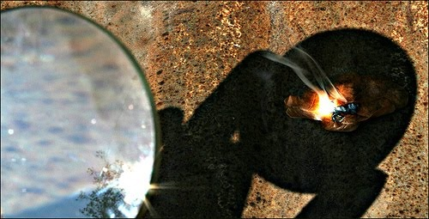
Solar Cooking in History
700 BC – Sunlit Fires
We know that all the way back to the 7th century B.C., humans figured out how to make fires by concentrating the sunlight with magnifying glass.

Slide 3
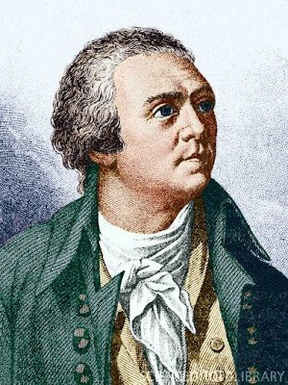
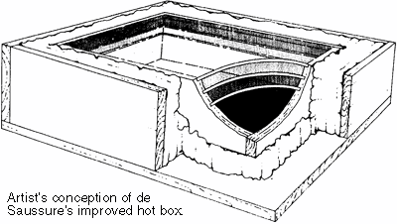
Solar Cooking in History
1767 – Swiss Physicist Horace de Saussure
Created the first solar “hot box” cooker

Slide 4
The main types of solar cookers
Box Style Cookers
Parabolic
Tube Style Cookers
Lens cookers

Slide 5
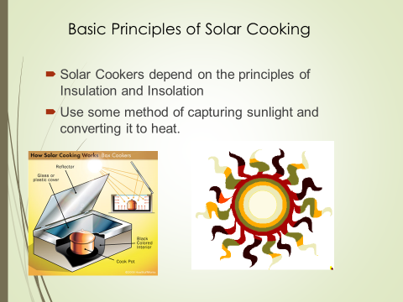

Slide 6
Solar Box Cooker Uses
Baking
Boiling
Broiling
Slow Cooking
Emergency Cooking
Water Purification
Food Dehydration

Slide 7
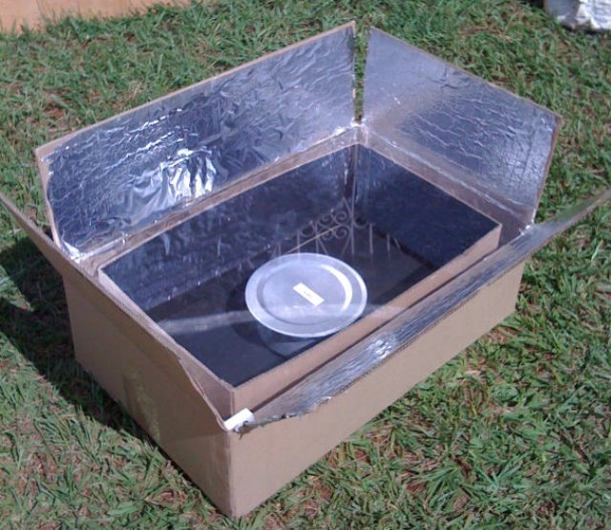
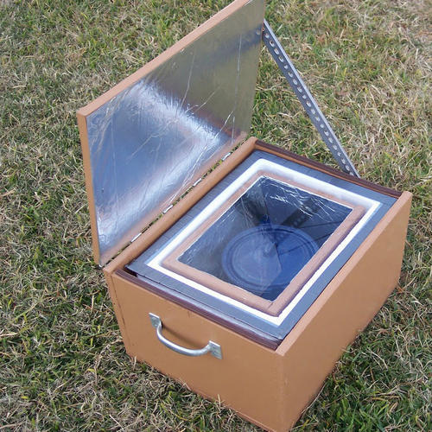
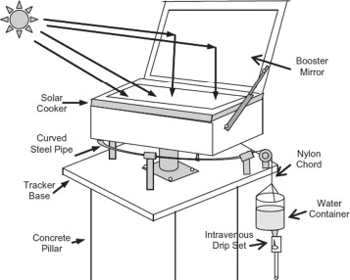
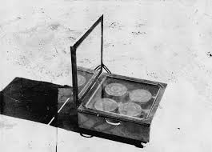
Home Made Variations

Slide 8
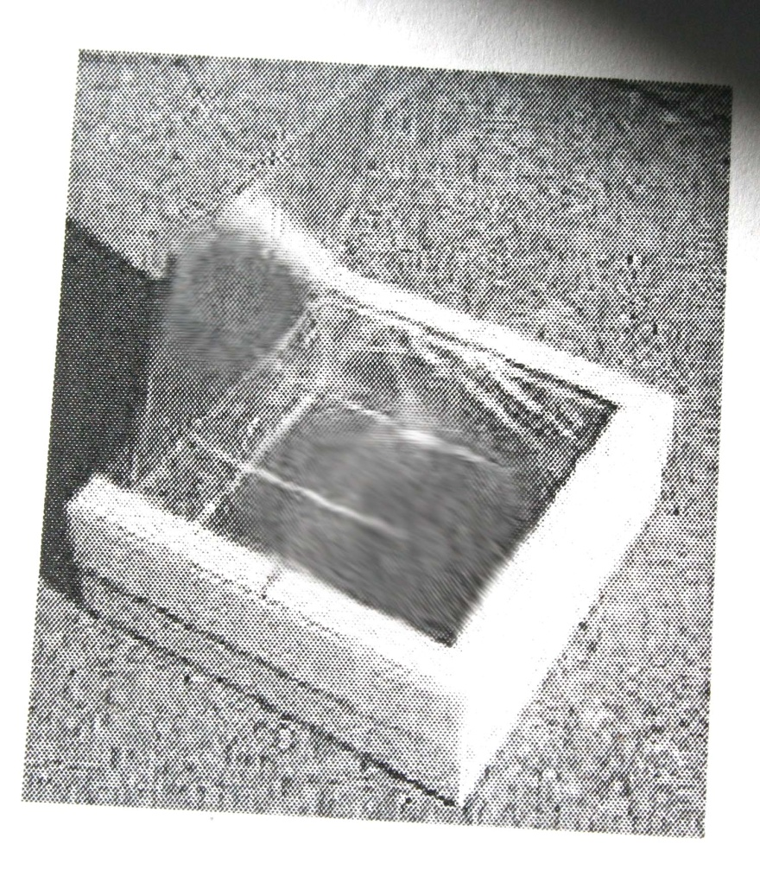
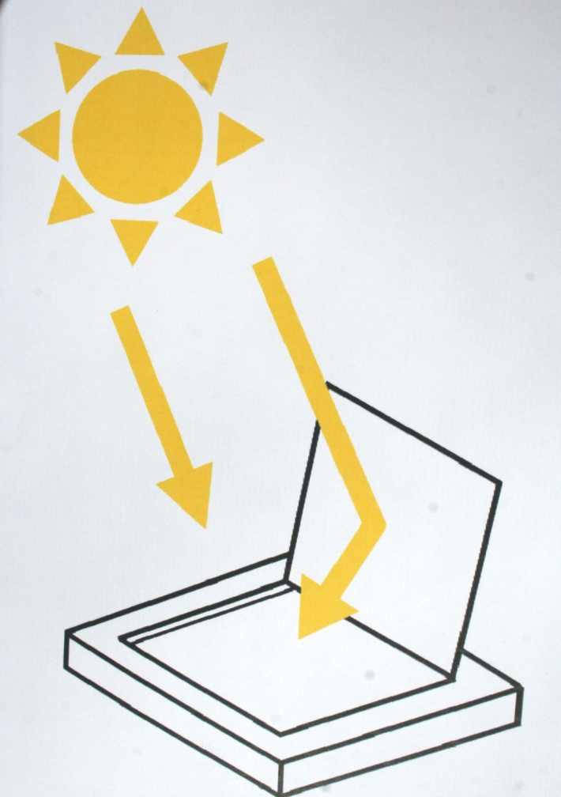
Pizza Box Style Cookers

Slide 9
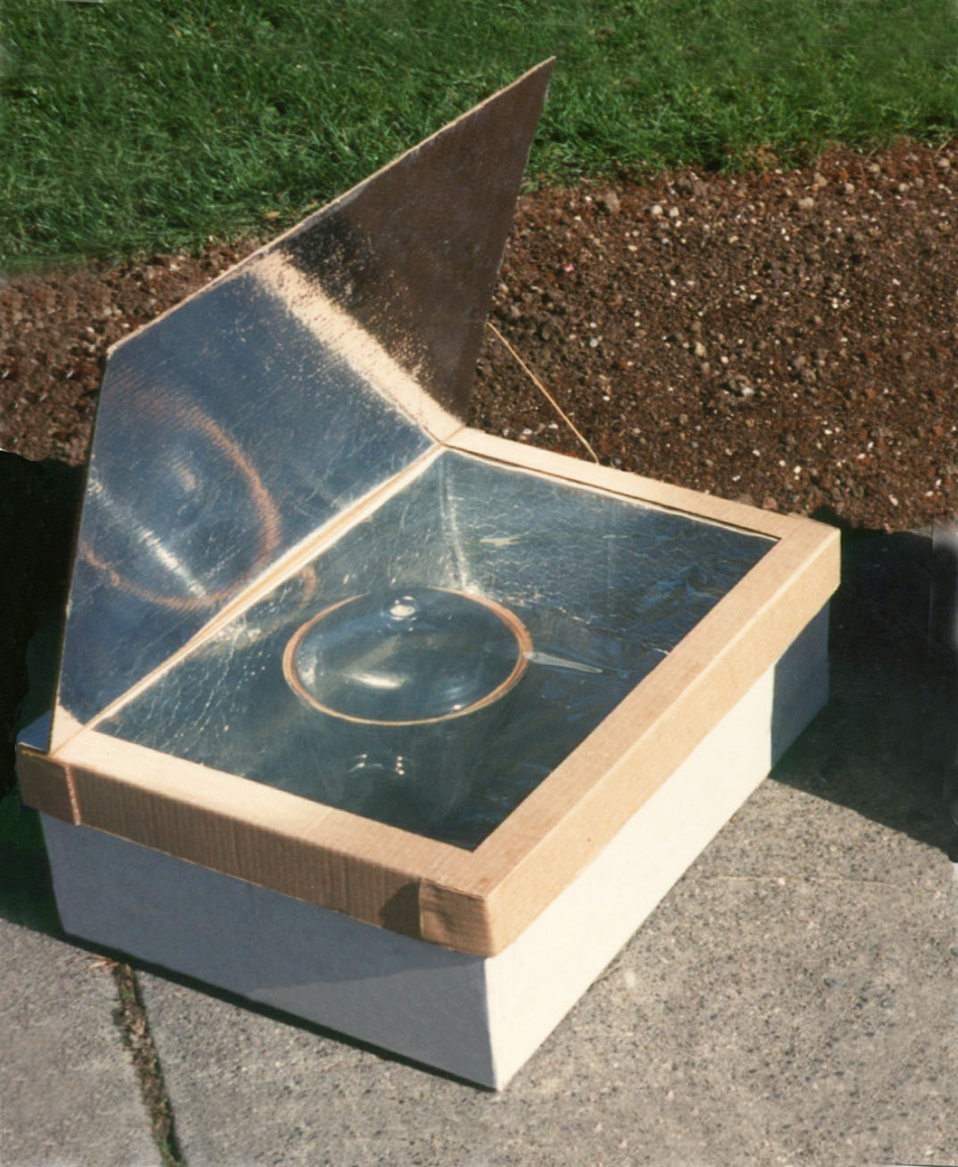
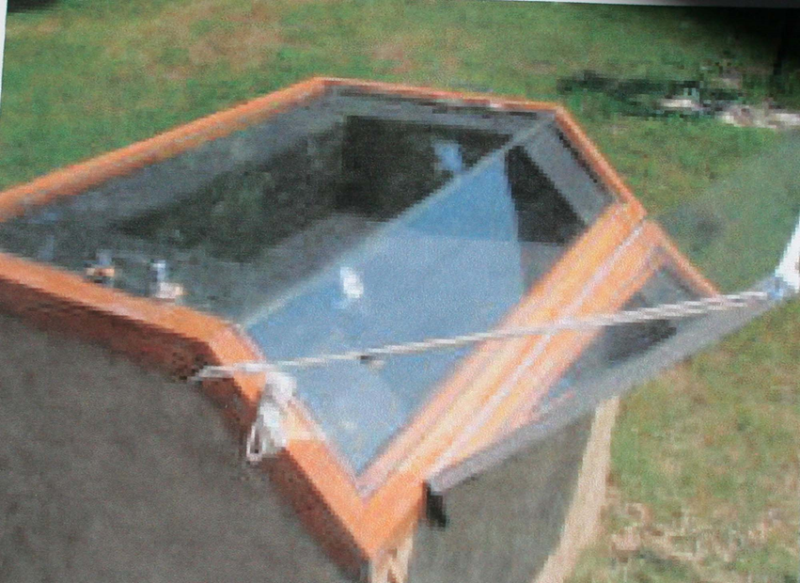
Cardboard box Solar Cooker
Smaller box set into a larger one with cardboard or newspaper insulation between them.
Adobe box with glass lid

Slide 10
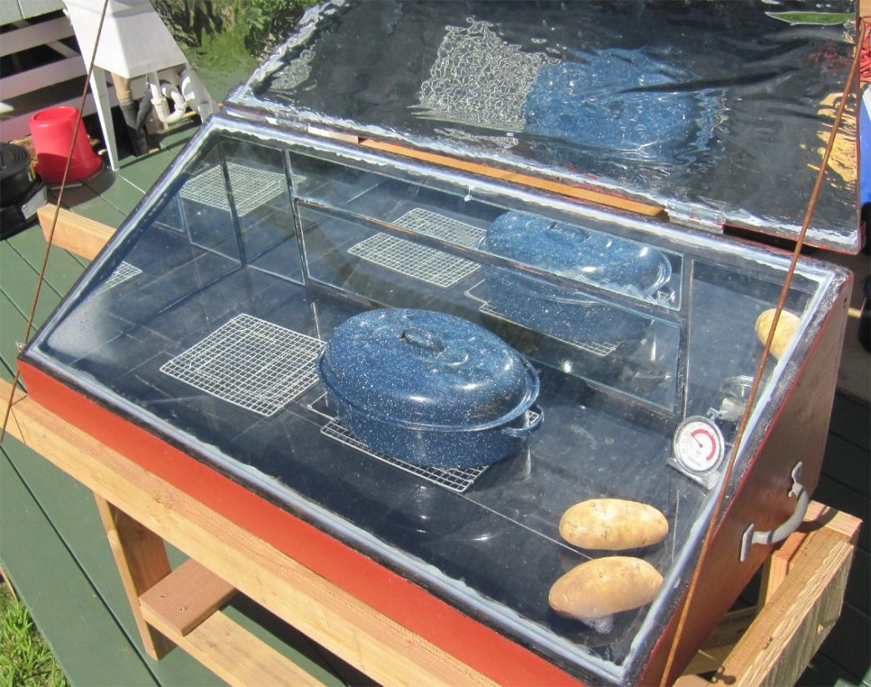
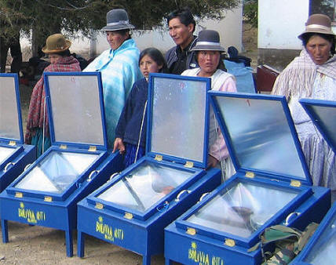
Various Home Made Cookers

Slide 11
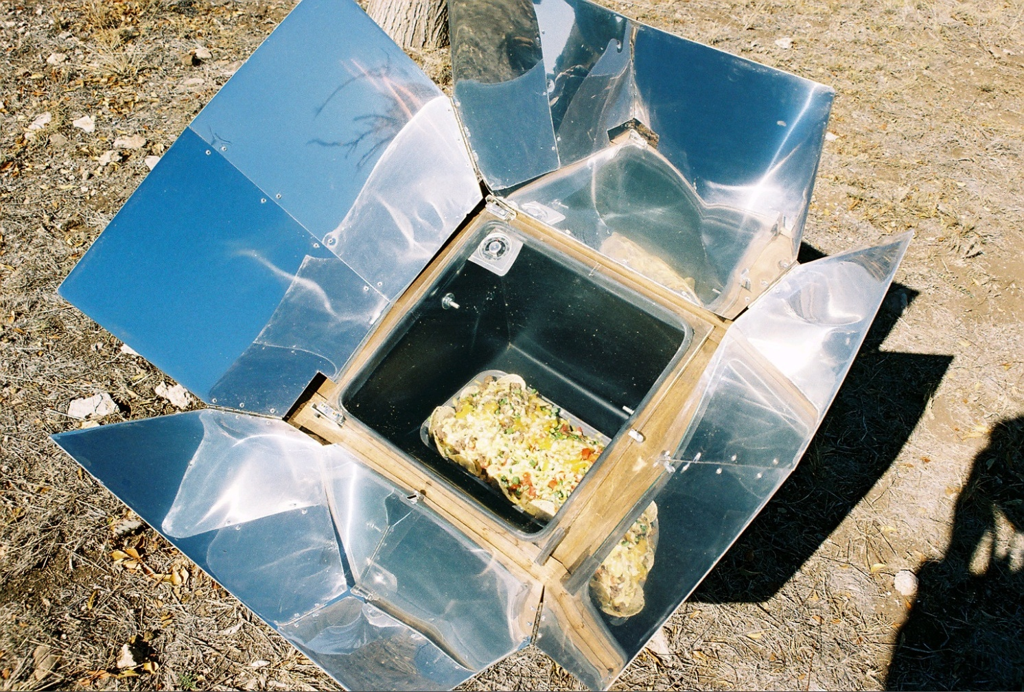
All American Sun Oven
The Ultimate Solar Cooking Appliance
Temps of 360-400 degrees F

Slide 12
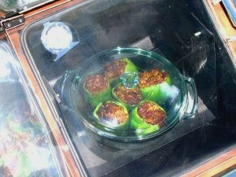
What can you cook with a Solar Oven?
Stuffed Bell Peppers
Christmas Turkey
Red Rice and Beans
Breads, Soups, Stews
Quiche
Potato, Rice or Noodle Casseroles
Corn on the Cob
Pretty much anything!

Slide 13
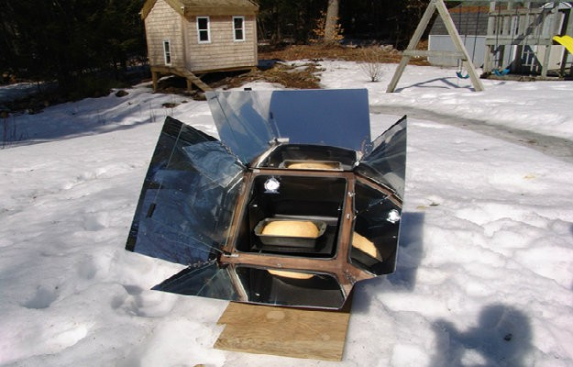
Yes, You can solar cook in the winter.

Slide 14
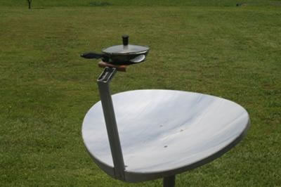
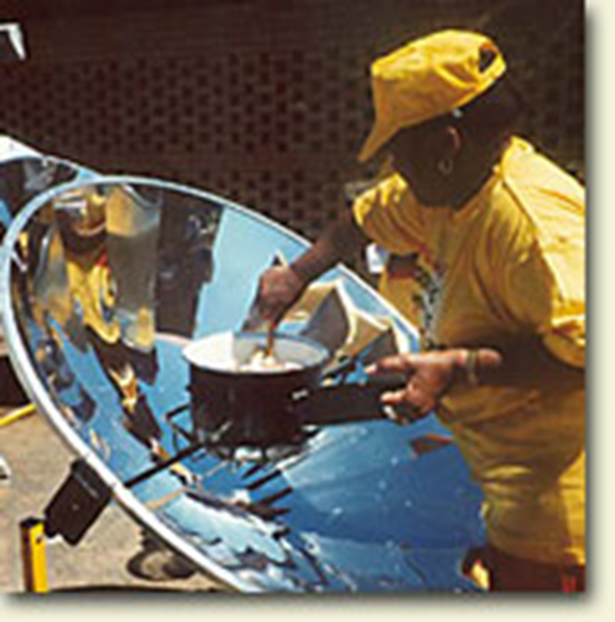
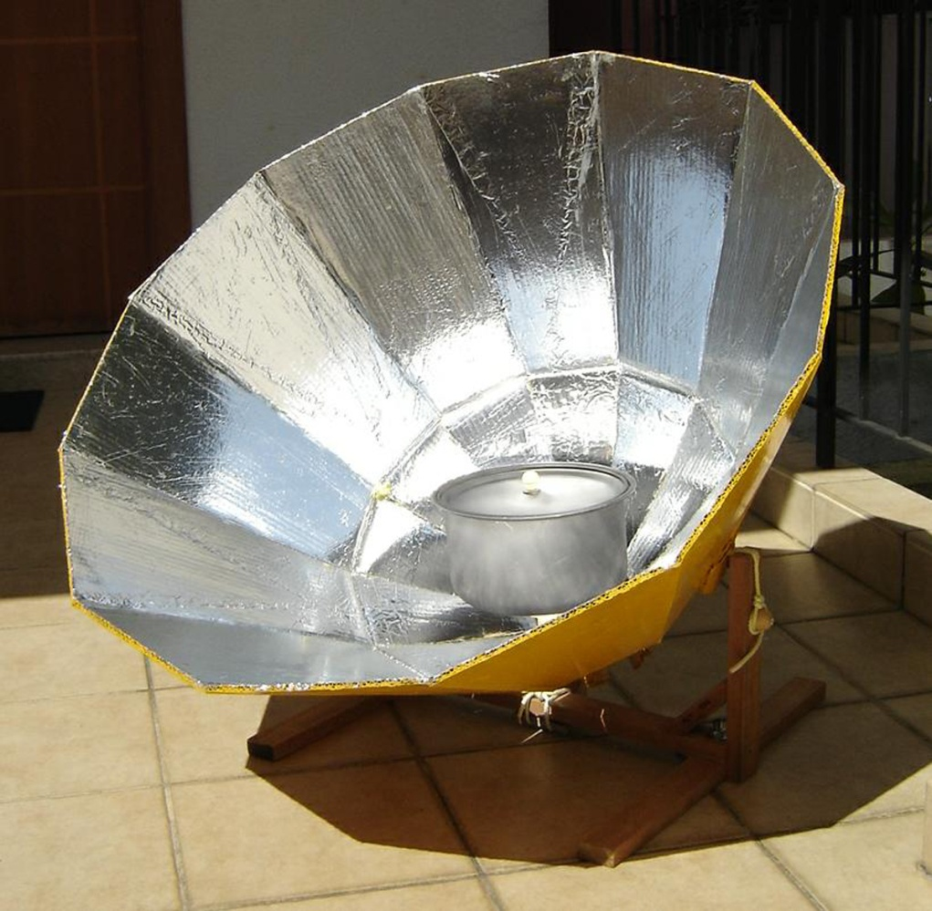
Parabolic cookers focus and reflect sunlight at a point above the unit. Great for frying.

Slide 15
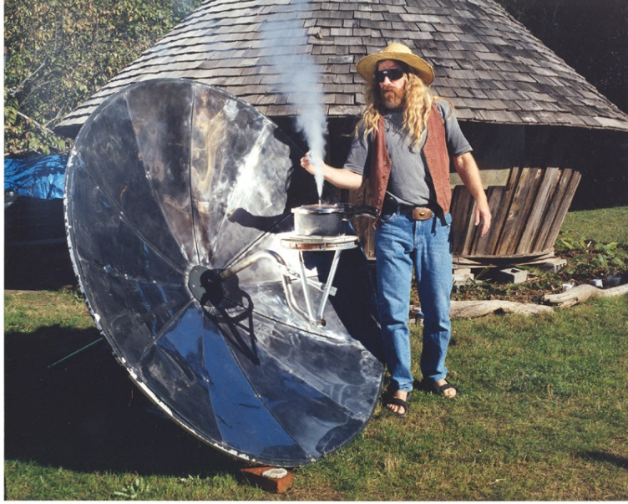
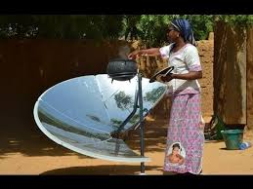
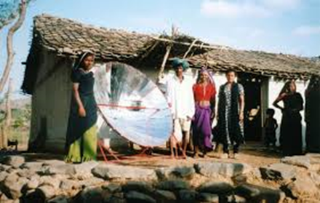
Parabolics can be unstable in high winds.

Slide 16
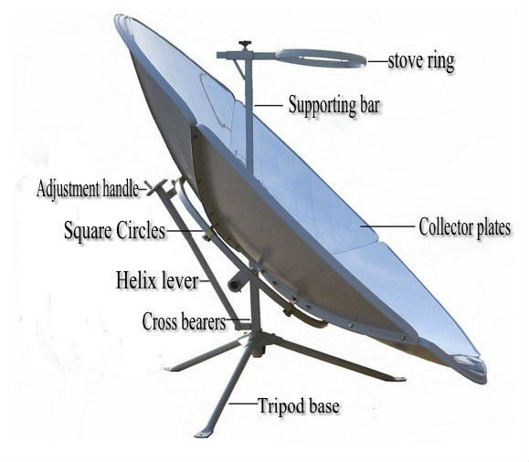
Parabolic Design

Slide 17
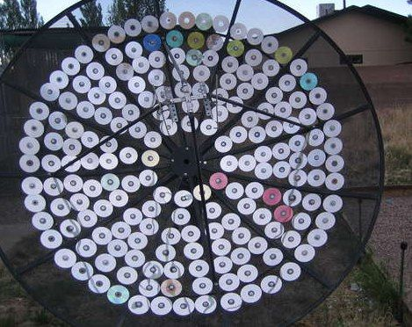
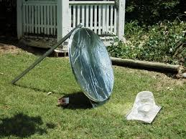
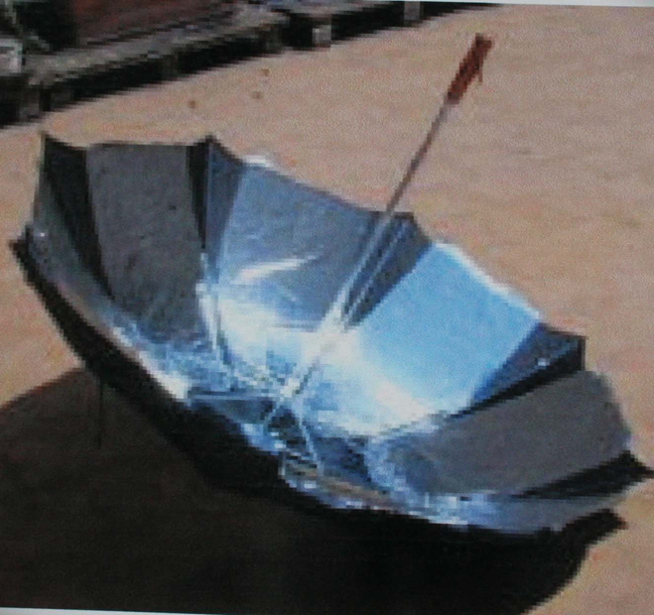
Some homemade Parabolic Cookers.

Slide 18
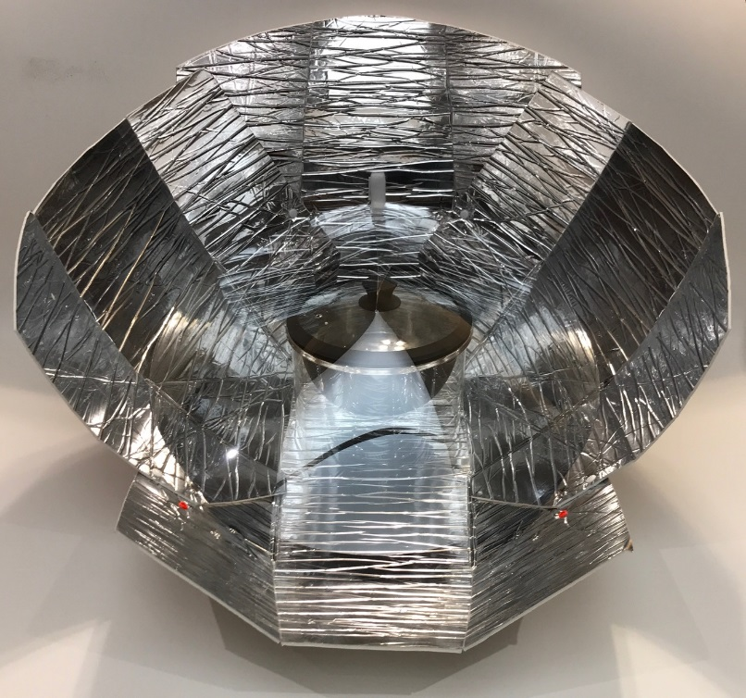
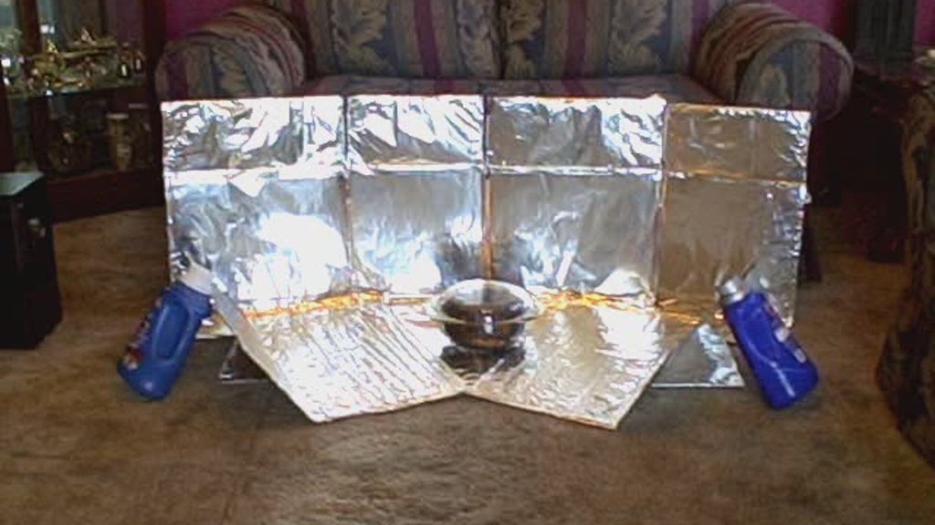
Parabolic Cookers capture the sun but do not have a container to retain the heat.
Glass bowl or black pot set inside common reflective materials like a car sunscreen.
Disadvantage – no insulation means quick cooling.

Slide 19
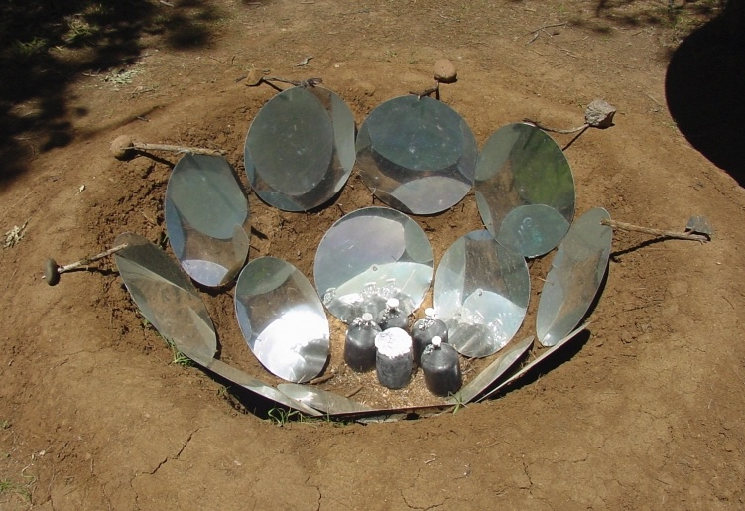
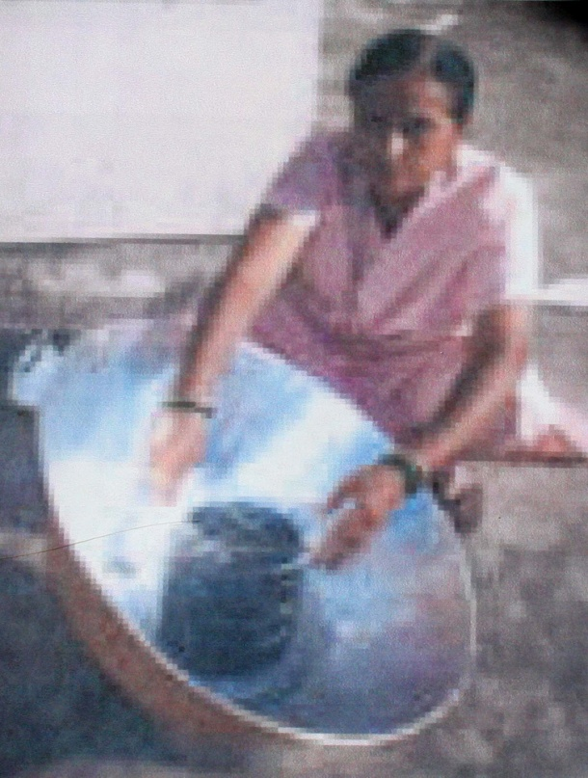
Pit lined with shiny metal and dark bottles on the bottom or a big Aluminum Bowl and black pot wrapped in heat resistant plastic.
Parabolic Alternatives.

Slide 20
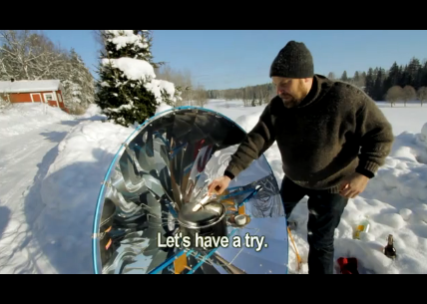
Good in the snow.

Slide 21
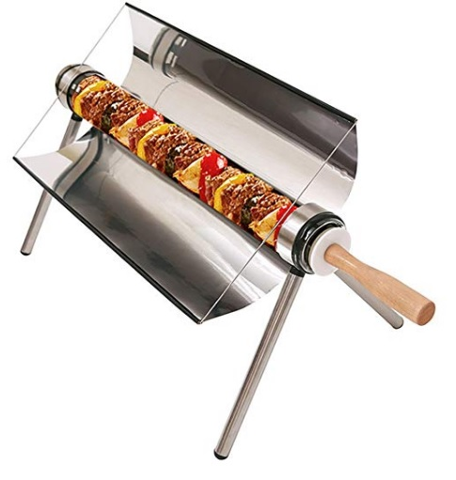
Tube Solar Cooker
Good for broiling and frying.

Slide 22
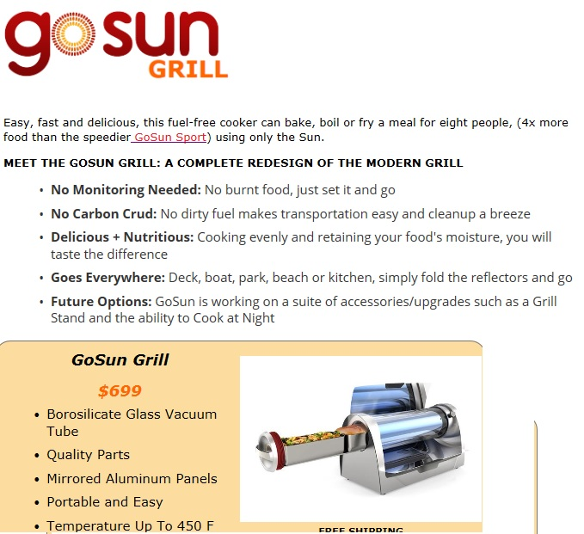

Slide 23
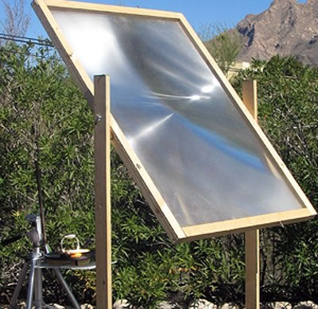
Fresnel Lens Cookers
Fresnel Lens is mounted and focuses light on pot behind it or…

Slide 24
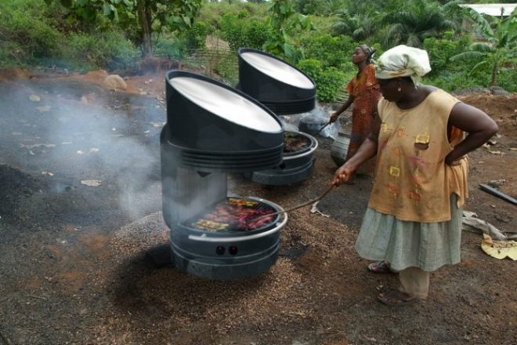
Fresnel Lens Cookers
…Under it on a cooking surface!

Slide 25
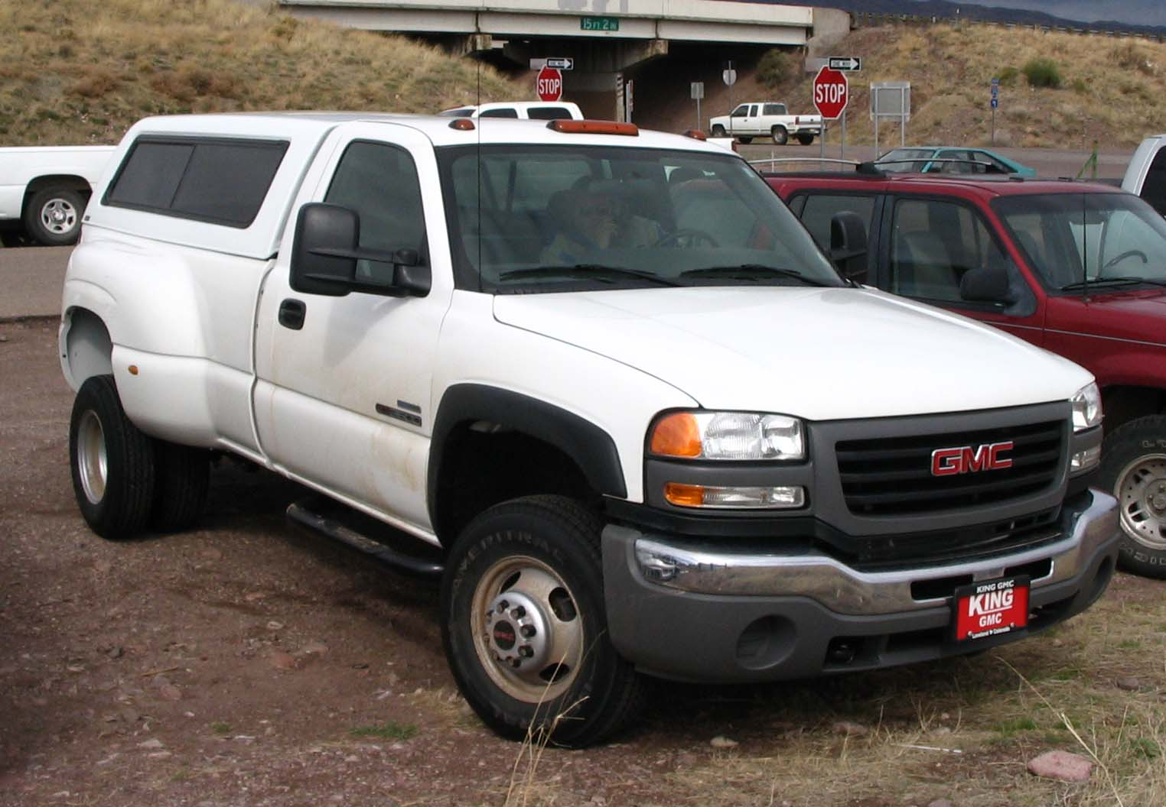
Alternate Solar Cooker/dehydrator

Slide 26
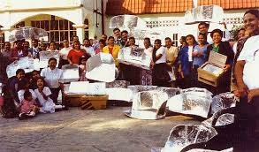

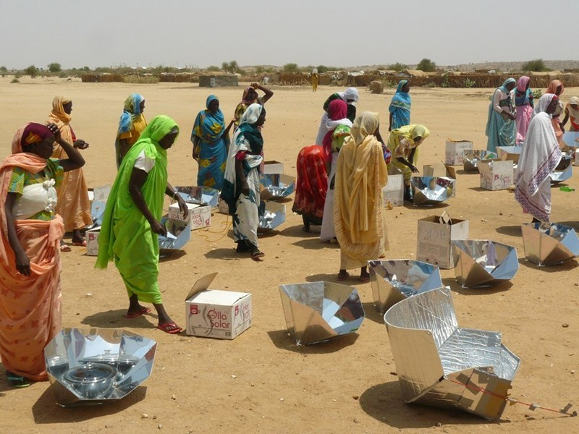
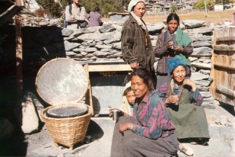
Solar Cooking can be a community experience!

Slide 27
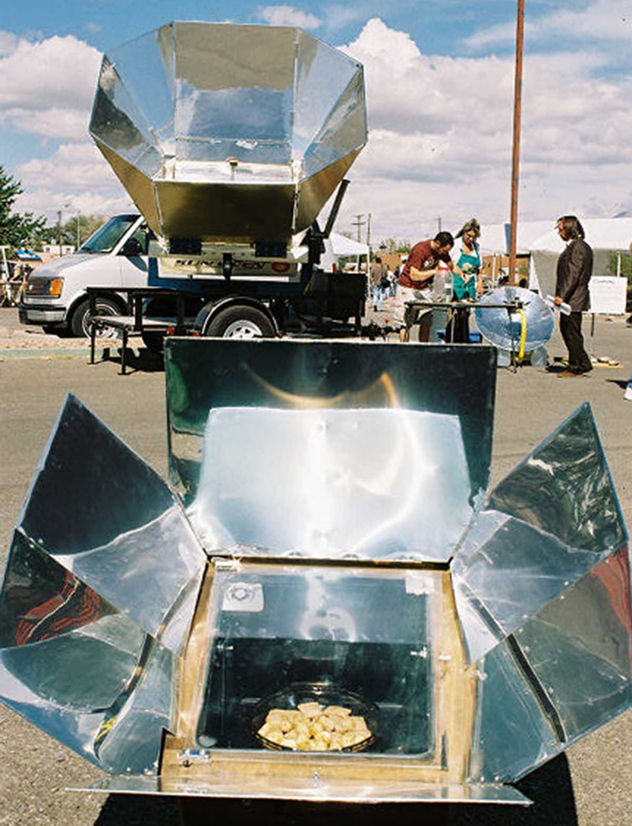
The
Solar Villager can cook
8 Turkeys
or
6 trays of cookies
or
40 Ears of Corn
or
20 loaves of bread at a time!

Slide 28
Advantages of using Solar to cook.
Keeps your house cooler in summer
Does not use electricity or gas
Saves money
When emergencies take out all power, you can still have a hot meal.
Food tastes Fantastic!

Slide 29
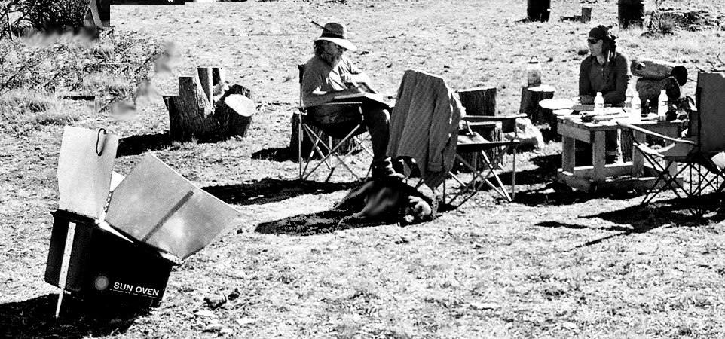
Can be used when camping when campfires or even propane campstoves are not allowed by the forest service.

Slide 30
Know your cooking location, choose a place where shadows will not fall on the oven.
When placing the oven, know where the sun comes up, where it is at noon, and where it will descend.
Expect cook time to be 30% longer than in a convection oven.

Slide 31
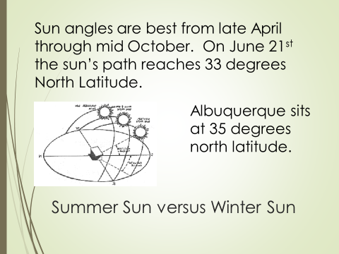

Slide 32
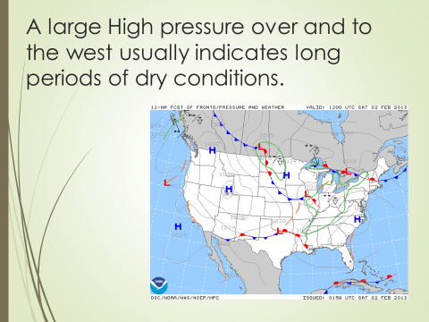

Slide 33
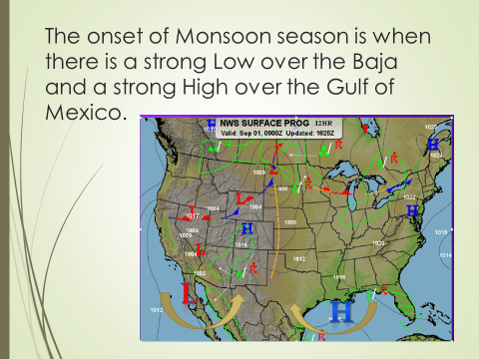

Slide 34
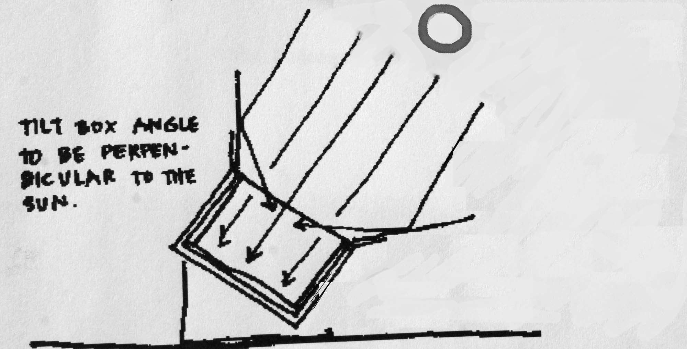
Tilt box towards the sun
Spin box to follow sun to keep temperatures high. Adjust every half hour for baked goods and eggs.

Slide 35
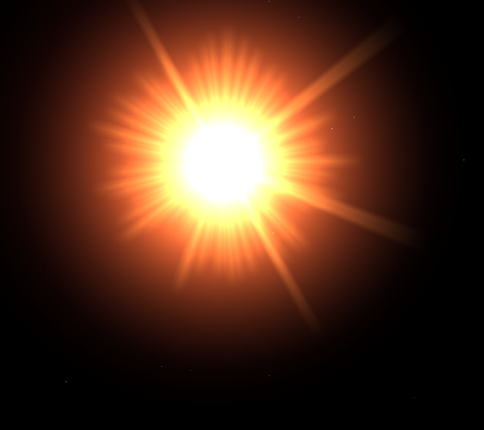
When slow cooking aim the oven at where you think the sun will be in an hour…then walk away for the next four hours.
This is a good practice for roasts, soups, stews, beans, rice and casseroles.

Slide 36
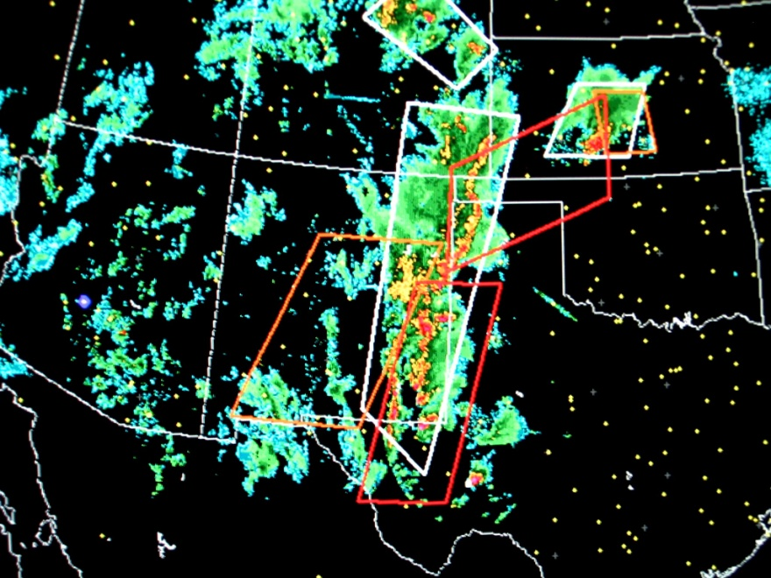
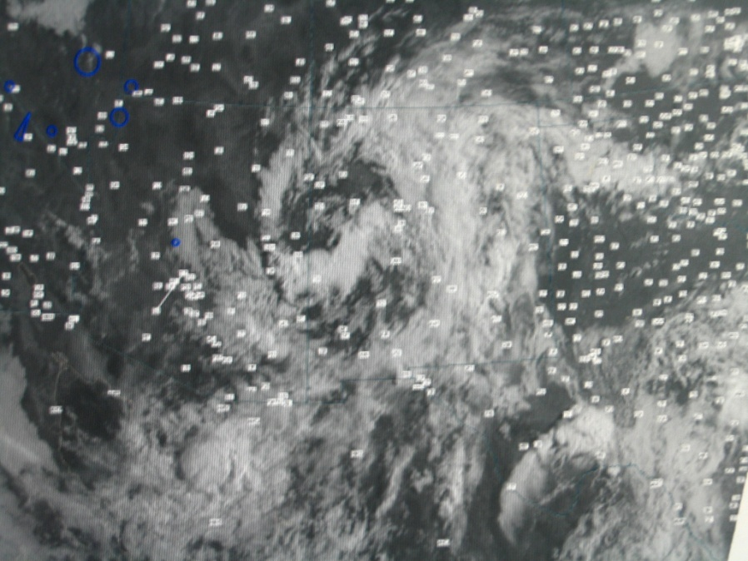
Solar Cooking
Requires that
You pay attention
To Mother Nature!

Slide 37

Clouds
Rain
Wind

Slide 38

Solar Cooking is still possible with a few clouds or a thin overcast cirrus layer – but stick to foods that need lower temperatures.

Slide 39
Best dishes for cooking in a Box Cooker
Thin Black metal covered pots
Clear Casserole Dishes
Dark Pottery Dishes
Dark metal baking dishes
Do not use white casserole dishes
Cast Iron? Not really. Too heavy
and only use aluminum if food is covering most of the surface. Will reflect sunlight back out.

Slide 40
All American Sun Oven
The Ultimate Solar Cooking Appliance
Temps of 360-400 degrees F

Slide 41


The All American Sun Oven has built in thermometer, 2 inches of insulation, a aiming device, heat tempered glass and folds up into a convenient carrying case weighing only 23 pounds.

Slide 42



Casserole dishes can be stacked.
Dark Clay pots retain heat well.
Thin walled black pots

Slide 43
General Information
Best Cooking Times
  Winter 10am to 4pm
  Summer 8am to 6pm
  Preheat the oven for half an hour prior to cooking
  When using recipes written for convection ovens add 30% longer cooking times

Slide 44
Hints and Tips
Use a roasting bag inside your pot for baking meats and turkeys.
Ove-Gloves work best when lifting the glass lids and removing hot cookware.
Treat the inside of the tempered glass with Rain-x to keep humidity from fogging the glass and lowering the temperature.
Tuck baking potatoes inside clean black socks and set around other dishes in oven.

Slide 45


Slide 46


Dehydrate in partial shade with the glass open ¼ inch.

Slide 47


Slide 48

Good book about Building Solar Cookers

Slide 49

How to cook with solar and which has a wide variety of recipes
Available today for $12.00

Slide 50

All American Sun Oven
Manufacturer Price $349.00
Order today for $287.00 delivered to your door.
Free copy of The Solar Chef with oven purchase.

Slide 51
The Basics of
Solar Cooking
Presented by Rose Marie Kern
LET’s EAT!

