Slide 1
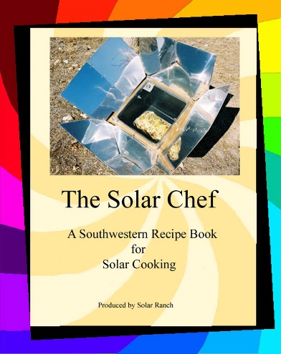
The Basics of Solar Food Dehydration
Presented by
Rose Marie Kern
Author of
The Solar Chef
A Southwestern Recipe Book for Solar Cooking

Slide 2
New Mexico is a great place for Solar!

Slide 3
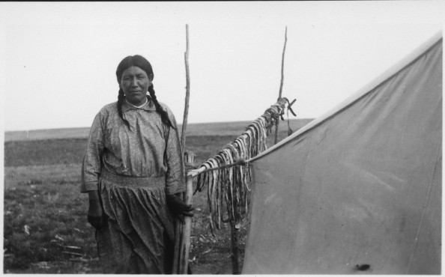
Solar Drying (dehydrating) food is one of the oldest and easiest methods of food preservation.
Dehydration is the process of removing water or moisture from a food product. Removing moisture from foods makes them smaller and lighter. 20 pounds of apples will dehydrate to 2 pounds.
Drying food is a way of preserving seasonal foods for later use.

Slide 4
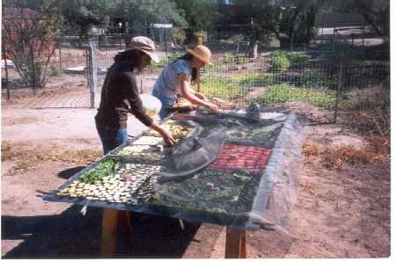
.
Foods can be spoiled by food microorganisms or through enzymatic reactions within the food.
Bacteria, yeast, and molds must have a sufficient amount of moisture around them to grow and cause spoilage.
Reducing the moisture content of food prevents the growth of these spoilage-causing microorganisms and slows down enzymatic reactions that take place within food.
The combination of these events helps to prevent spoilage in dried food.

Slide 5
Summer Sun versus Winter Sun
Sun angles are best from late April through mid October. On June 21st the sun’s path reaches 33 degrees North Latitude.
Albuquerque sits at 35 degrees north latitude.

Slide 6
A large High pressure over and to the west usually indicates long periods of dry conditions.

Slide 7
The onset of Monsoon season is when there is a strong Low over the Baja and a strong High over the Gulf of Mexico.

Slide 8
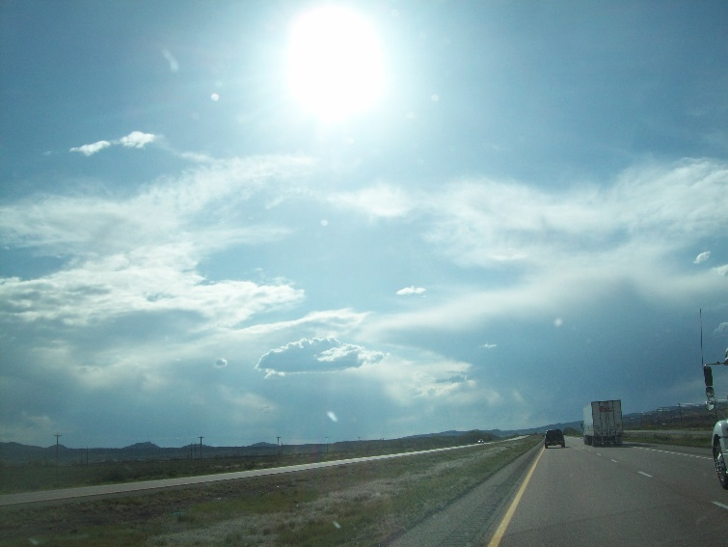
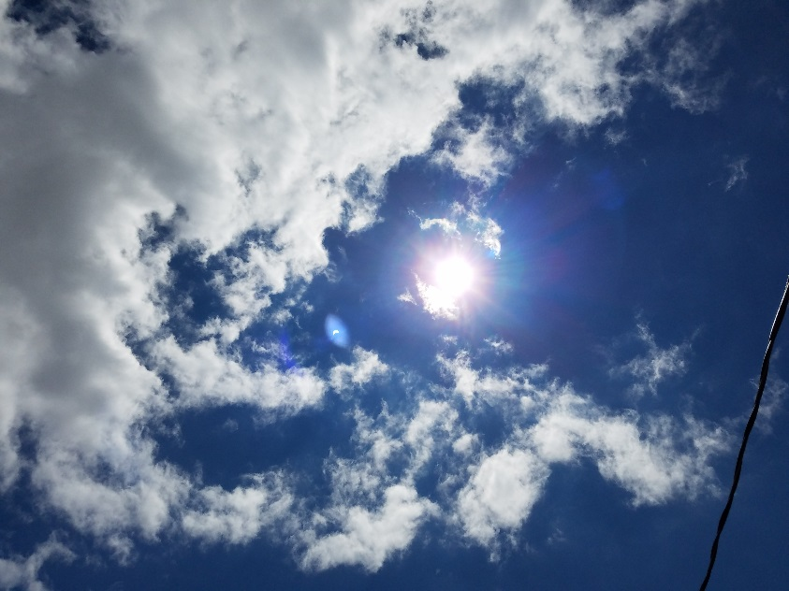
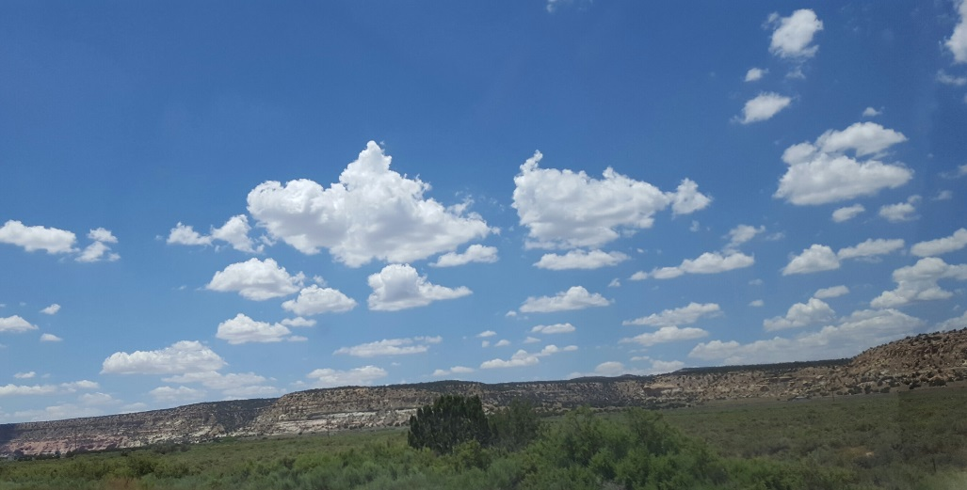
Meteorology
Best Solar Food drying times using the rack method in New Mexico are during the summer and fall primarily in the morning at/after 9am until around 5pm.
Drying can be accomplished with partial or thin clouds as long as the ambient temperature remains above 85 degrees.

Slide 9
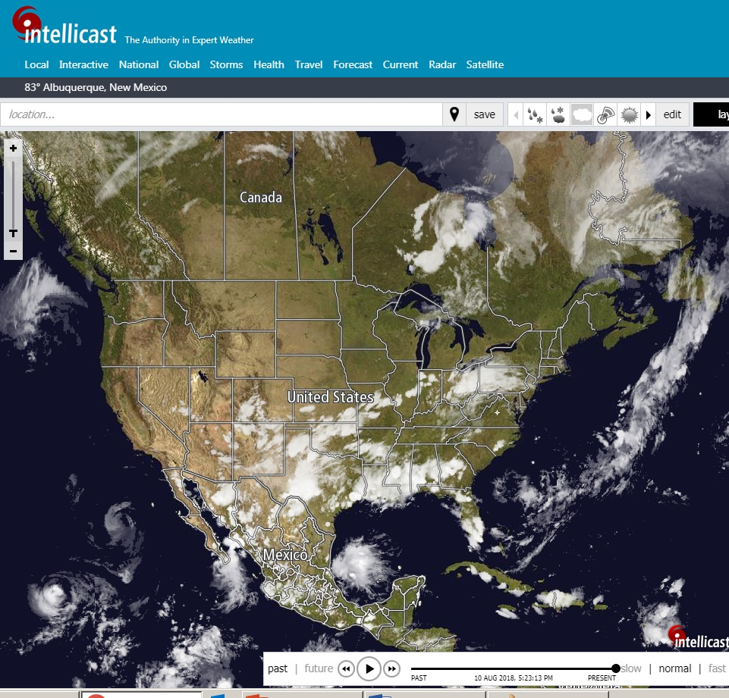
Solar Cooking and food dehydration require that you pay attention to Mother Nature!
Become familiar with the way weather moves and builds by watching satellite and radars daily.
In general weather systems move primarily from west to east across north America.
Check the local forecast the day before!

Slide 10
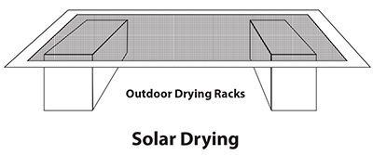
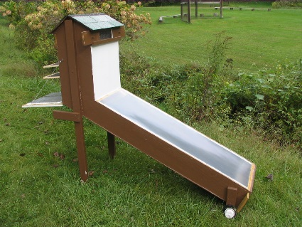
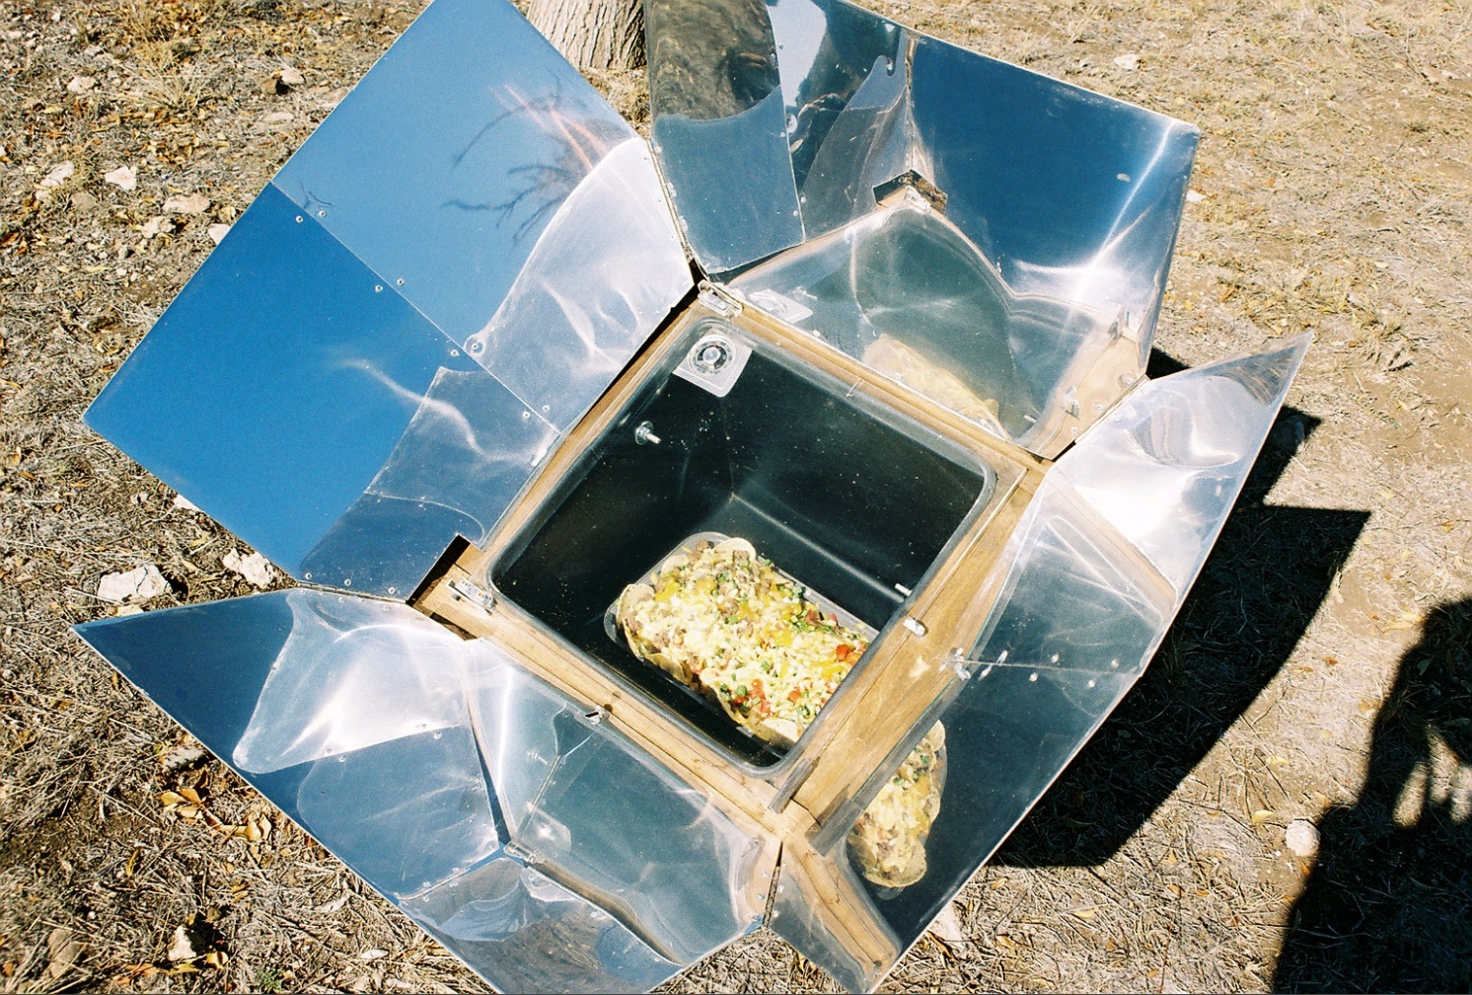
Types of Solar Food Dehydration
Laying food out on screens and trays – Temps in NM between 120 and 150 degrees possible in summer.
Solar Dehydrator that concentrates sunlight - temps up to 200 degrees possible
Using a Sun Oven – Temps up to 420 degrees possible – mitigate temp by changing angles or setting in dappled shade.

Slide 11
Tools for Solar Food Dehydration
Screens, racks, hardware cloth, or trays.
For herbs: paper or plastic grocery bags
Food Processer or knives to slice thinly
Outdoor thermometer
Sheer curtains or cheesecloth and a way to keep them weighted.
Tables to keep food up and away from insects and animals.

Slide 12
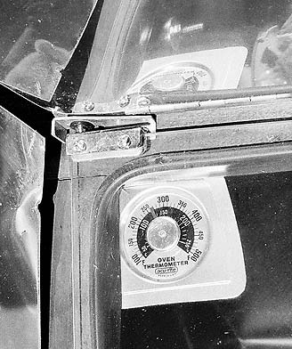
Sun Oven Drying
While perfect for solar cooking, a sun oven requires a lot of attention to keep it from overheating while drying. This is one time when you do NOT point the oven directly at the sun!
Sun Ovens are best for jerky because the temperature can get high enough to kill all the bacteria.
They also work for larger, juicier fruits or vegetables requiring drying times which may take days.
While actively drying, the glass lid is propped open to expel moisture. Close it at night to protect the food until the next day.

Slide 13
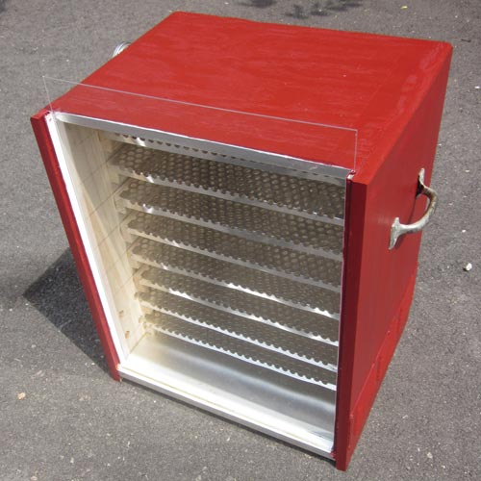
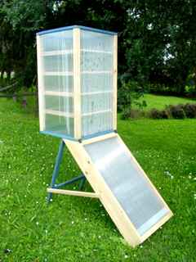
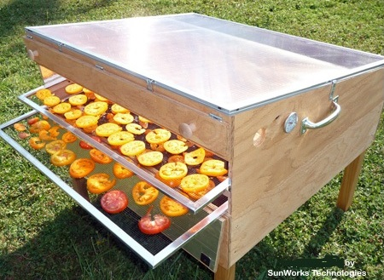
Solar Food Dehydrators
Solar Food Dehydrators protect the food while gathering sunlight and converting it to heat.

Slide 14
Sun drying on Racks/Tables
Dry fruit and vegetables on hot, dry, breezy days with a minimum temperature of 85°F—the hotter the day the better. Relative humidity should be below 60%.
Because the weather is uncontrollable, sun-drying can be risky, and it can take several days to complete the process.
Unfinished Sun-dried foods must be covered or brought under shelter at night. Cool night air condenses, which adds moisture back to the food and slows the drying process.

Slide 15
Sun drying on Racks/Tables
Place prepared foods on drying trays. Trays measuring about 14 in. × 24 in. × 1 in. are an easy size to handle. Options for home-constructed drying trays are window screens, hardware cloth, oven racks, or wood lathe.
Since aluminum screening reacts with acids in the fruit, it is less desirable. Do not use galvanized metal, or copper, screening.
Place trays of food away from dusty roads and yards. Elevate them at least 1 inch above the table to allow good air circulation below the food

Slide 16
Sun drying on Racks/Tables
Cover the food with a muslin or cheesecloth tent to protect it from insects. Dry in direct sunlight; move trays periodically to ensure direct sun exposure. If weather turns rainy, you will have to complete the drying process using another method.
The National Center for Food Preparation advises practitioners to heat all sun-dried foods in a 150°F oven for 30 minutes to destroy insects or insect eggs, which may be present on sun-dried foods, and to remove additional moisture in thicker pieces.

Slide 17
Alternate Solar Food Dehydrator
Park Facing south. Roll windows up leaving small crack on top to let heat escape. Set trays and racks on dashboard or seats. Make sure you like the smell of whatever you are drying.

Slide 18
Fruits/Vegetables suitable for drying Dry Veggies and Fruit between 120-150°F
Apples
Apricots
Beets
Carrots
Bananas
Sweet Corn
Cherries
Garlic
Grapes
Coconuts
Horseradish
Celery
Mushrooms
Figs & Dates
Okra
Onions
Nectarines
Parsnips
Peaches
Parsley
Pears
Peas
Pineapples
Peppers
Plums
Potatoes
Pumpkins
Tomatoes

Slide 19
Blanching
Some fruits and vegetables require blanching via water, steam or syrup prior to drying. Other require cooking completely or not cooking at all.
Boiling water:
Carrots should be blanched for 3.5 minutes in water
Potatoes 3 minutes
Peas for 2 minutes
Pumpkin 1 minute
It is recommended that beets be completely cooked prior to drying.
Items which do not require blanching include:
Beans, Corn, Garlic, Horseradish, mushrooms, okra, onions, parsley and peppers.
Vegetables are dry when they are brittle and crispy.

Slide 20
Fruits may be dipped in ascorbic acid or citric acid in place of blanching to keep them from discoloring.
Test for dryness by cutting the fruit. There should be no moist areas in the center.
Times on next slide are estimated for number of hours of active sunlight at 140 degrees or higher.
* Drying times for whole fruits. Cutting fruit into slices may shorten drying time.

Slide 21
Fruits
Blanching and Drying Times for Select Fruits
Fruit Method and time Drying Time in hours
Apple slices Steam 3-5 minutes 6 – 12 hours*
Syrup 10 minutes
Apricots Steam 3-4 minutes 24-36 hours*
Syrup 10 minutes
Bananas Steam 3-4 8 – 10 hours*
Syrup 10 minutes
Cherries Syrup 10 minutes 8-10 hours*
Figs not necessary 6-12 hours*
Grapes (seedless) not necessary 12-20 hours*
Nectarines Steam 8 minutes 36-48 hours*
Peaches Steam 8 minutes 36-48 hours*
Syrup 10 minutes
Pears steam 6 minutes 24-36 hours*
Syrup 10 minutes
Pineapples not necessary 24-36 hours*
Plums not necessary 24-36 hours*

Slide 22
Steps for water blanching (vegetables only):
Use a blancher or a deep pot with a tight-fitting lid.
Fill the pot two-thirds full with water, cover, and bring to a rolling boil.
Place vegetables into a wire basket and submerge them into the boiling water for the recommended time
Remove vegetables and place in cold water to stop cooking.
Drain and place vegetables on drying tray.

Slide 23
Steps for syrup blanching (fruits only):
Combine 1 cup sugar, 1 cup light corn syrup, and 2 cups water in a pot.
Add 1 pound of fruit.
Simmer 10 minutes
Remove from heat and keep fruit in syrup for 30 minutes.
Remove fruit from syrup, rinse, drain, and continue with dehydration step.

Slide 24
Dipping is a pretreatment used to prevent fruits such as apples, bananas, peaches, and pears from turning brown.
Ascorbic acid, fruit juices high in vitamin C (lemon, orange, pineapple, grape, etc.), or commercial products containing ascorbic or citric acid may be used for dipping.
For example, dipping sliced fruit pieces in a mixture of ascorbic acid crystals and water (1 teaspoon ascorbic acid crystals per 1 cup of water), or dipping directly in fruit juice for 3 to 5 minutes will prevent browning.
.

Slide 25
The National Food Preservation Center states that foods dried outdoors must be pasteurized to destroy any insects and eggs. This can be done with heat or cold. To pasteurize with heat, place dried food evenly in shallow trays no more than 1 inch in depth. Fruits should be heated at 160°F for 30 minutes. To pasteurize with cold, fruits can be placed in the freezer at 0°F for 48 hours.
Safety Tip

Slide 26
Conditioning Dried Foods
Food should be conditioned for a week before being packaged for long-term storage. To condition food, place it in a container such as a cloth sack or a clear, covered container. Conditioning allows any remaining moisture to redistribute itself throughout the food.
Watch for moisture beads on containers. If they form, continue drying food. If using a cloth bag, hang it in a convenient location and shake the bag daily to redistribute food and moisture.

Slide 27
Storing Dried Foods
Place dried food in freezer-weight plastic storage bags, press out air, and put the bags in containers with tight-fitting lids. Store in a cool, dark, dry area.
Dried foods store well at room temperature for a month. Refrigerate foods if they will be used within three months. Dried foods should be frozen if they will be used between three months and one year. Foods should be used within one year.

Slide 28
Using Dried Foods
Dried meat jerky, is normally not rehydrated and is eaten in the dried state, but can be soaked in water similar to dried vegetables and used in stew or soup.
Dried vegetables used in soups rehydrate during the cooking process. Vegetables can also be rehydrated by soaking them in 1 1/2 to 2 cups of water per cup of dried vegetable. If necessary, add more water during the soaking process.
To rehydrate dried fruit, cover it with boiling water, let stand for 5 minutes, and drain. Dried fruit may also be steamed for 3–5 minutes until plump. Fruit may be eaten immediately or used in a recipe.

Slide 29
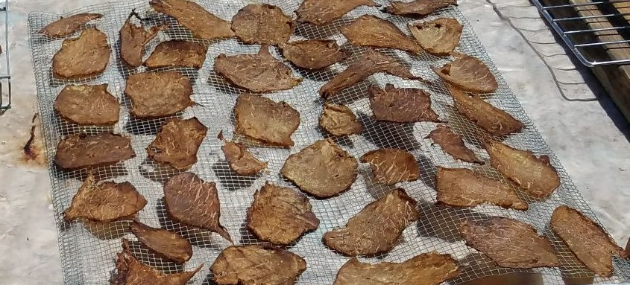
Sun Drying Safe Jerky
WARNING: NMSU and Blue Book do not recommend Sun Drying as an option due to the requirement for higher temperatures.
Jerky is raw meat or fish which is salted or marinated then dried. Lean meats are the best. Flank, round or sirloin tip. Too much fat may impede the process and become rancid.
Jerky can be made from almost any lean meat, including pork, venison, and smoked turkey.

Slide 30
Jerky
Partially freeze the meat to make slicing it easier – or have the butcher at the store it is purchased from use the meat slicer at the thinnest setting.
Meats should be “cured” prior to drying. Curing treats the meat in such a way as to prevent spoilage. Dry cures are salt and seasonings rubbed on the meat surface. Meats can be soaked in brine cures or marinades. It should be done for at least 6 hours or overnight.
To reduce the risk of spoilage the meat should be brought to an internal temperature of 160 degrees F for at least 5 minutes either prior to drying by boiling or after drying it can be set in an oven at 275 Degrees for 10 minutes.

Slide 31
Jerky
Slice partially frozen meat into strips no thicker than ¼ inch. Trim and discard any fat. Meat can be marinated for flavor and tenderness.
Drain strips on a clean, absorbent towel. Place strips in a single layer, making sure they don’t touch or overlap. Dehydrate at 140°F to 160°F until a test piece will crack, but not snap, when bent. Remove dried strips from rack and cool.
If the meat strips were not heated to 160°F during or prior to drying, you may want to do this in an oven after drying. Place the dried strips on a baking sheet and cook at for 275°F for ten minutes. This process adds an additional safety step to the process.

Slide 32
Storing meat jerky
Meat strips should be packaged in glass jars or heavy plastic storage bags.
Jerky can be stored at room temperature for 2 weeks in a sealed container.
For the longest shelf life, flavor, and quality jerky, store in the refrigerator or freezer.

Slide 33
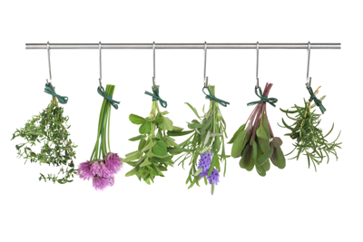
Sun Drying Herbs
Herbs should be harvested shortly after sunrise and never in wet or humid conditions.
Herbs can be dried on racks or by hanging them upside down by their stems.
Place your herbs in a well ventilated, dry, cool environment with plenty of air space. Do not hang in full sun.
Herbs are done when they are brittle. They should be stripped from the stems and placed in a Ziploc bag or sterilized jar.

Slide 34
Sun Drying Fruit Leathers
Wash fresh fruit in cold water removing peels, seeds and stem. Cut into chunks and puree. (apple sauce or other cooked fruit purees work well)
Add 2 teaspoons of lemon juice for each 2 cups of fruit puree. 1 to 2 tbsps of honey, sugar or agave can be added as desired.
Line the dehydrating trays with parchment paper or spray with non-stick spray. Pour puree over tray about 1/8th inch thick.

Slide 35
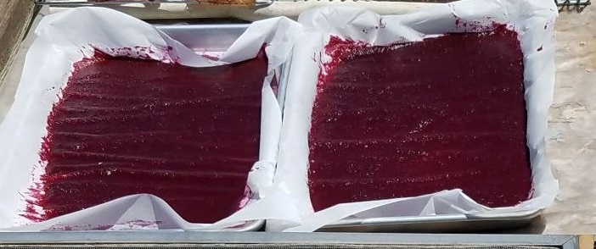
Sun Drying Fruit Leathers
Set out as soon as possible in the morning after the temperature is at least 85 degrees Fahrenheit. Drying takes 8 to 10 hours at between 120 and 150 degrees in full sun. If leather is not done by sunset or if it looks like rain, take it inside, keeping it in a sanitary space, like an oven, until it can be set out again the next day, or finish in the oven at lowest setting.
When leather is done it should pull easily away from the edges of the pan or paper and can be rolled into a tube. Place in a ziploc bag and refrigerate.

Slide 36
References for Solar Dehydration
NMSU Food Drying Guide http://aces.nmsu.edu/pubs/_e/E322/welcome.html
Books
Ball Blue Book: Guide to Preserving
The Solar Food Dryer: How to Make and Use Your Own Low-Cost, High Performance, Sun-Powered Food Dehydrator by Eben Fodor
Dehydrating Food - A Beginner’s Guide by Jay & Shirley Bills

